Slide 1
Convolution Neural Network
Perception in Artificial Intelligence

Slide 2
Recall Neural Networks
Neural Networks receive an input (a single vector)
Transform it through a series of hidden layers
Each hidden layer is made up of a set of neurons, where each neuron is fully connected to all neurons in the previous layer
Neurons in a single layer operate completely independently and do not share any connections
Last fully-connected layer is called the “output layer” and in classification settings it represents the class scores

Slide 3
Recall Neural Networks
Suppose you have to design a Neural Networks for classifying images into categories: cat, dog, monkey, human.
Also the network consists of a single input layer, hidden layer and output layer.
Moreover, the size of an image is 50*50, number of units at hidden layer are 100.
What will be the size of weight matrix for hidden layer and output layer?

Slide 4
Recall Neural Networks
In CIFAR-10, images are only of size 32x32x3 (32 wide, 32 high, 3 color channels)
How much weights do we need for a single fully-connected neuron in a first hidden layer?

Slide 5
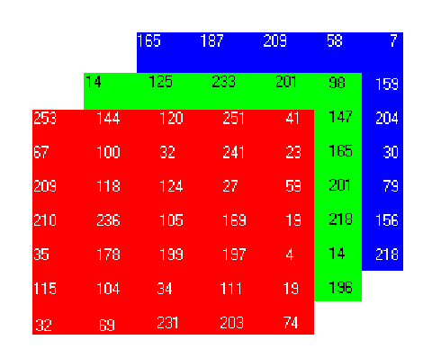
Recall Neural Networks
In CIFAR-10, images are only of size 32x32x3 (32 wide, 32 high, 3 color channels)
How much weights do we need for a single fully-connected neuron in a first hidden layer: 32*32*3 = 3072 weights.

Slide 6
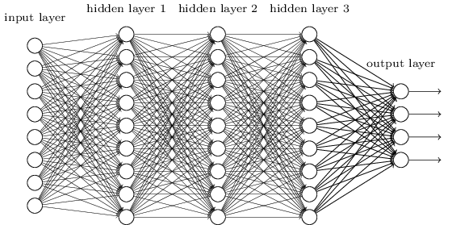
Smaller Network: Convolutional Neural Network
Do we really need all the edges?
Can some of these be shared?

Slide 7
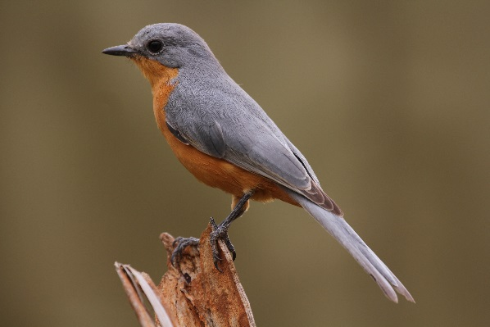
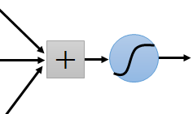
Smaller Network: Convolutional Neural Network
Idea: Patterns are often much smaller than the whole image, there is no point of input whole image into the network
Can represent a small region with fewer parameters
“beak” detector

Slide 8
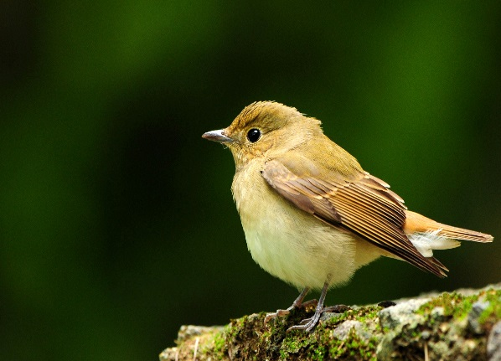
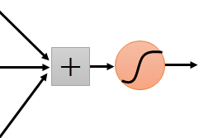

Same pattern appears in different places:
They can be compressed!
What about training a lot of such “small” detectors and each detector must “move around”.
“upper-left beak” detector
They can be compressed
to the same parameters.
“middle beak” detector

Slide 9
Neural Networks -> Convolution Neural Networks (CNN)
Instead of connecting a neuron to all of the neurons of the previous layer, connect each neuron to a some neurons in the previous layer.

Slide 10
Neural Networks -> Convolution Neural Networks (CNN)
Instead of connecting a neuron to all of the neurons of the previous layer, connect each neuron to a some neurons in the previous layer.

Slide 11
Neural Networks -> Convolution Neural Networks (CNN)
Instead of connecting a neuron to all of the neurons of the previous layer, connect each neuron to a some neurons in the previous layer.
Input layer
Convolution layer

Slide 12
Neural Networks -> Convolution Neural Networks (CNN)
Instead of connecting a neuron to all of the neurons of the previous layer, connect each neuron to a some neurons in the previous layer.
Input layer
Convolution layer
Full connected layer

Slide 13
Neural Networks -> Convolution Neural Networks (CNN)
Instead of connecting a neuron to all of the neurons of the previous layer, connect each neuron to a some neurons in the previous layer.
Single Dimensional Convolution
Input layer
Convolution layer
Full connected layer

Slide 14

1D Convolution
Z =
z1
W =
w1
w2
X =
x1
x2
x3
Notes:
You have filters and you are searching in an image the shapes of the filters. Learning is about finding filters that are good for detecting objects. Generally, finding properties of data occurring more often than noise.

Slide 15

1D Convolution
Z =
z1
z2
W =
w1
w2
X =
x1
x2
x3
Notes:
You have filters and you are searching in an image the shapes of the filters. Learning is about finding filters that are good for detecting objects. Generally, finding properties of data occurring more often than noise.

Slide 16
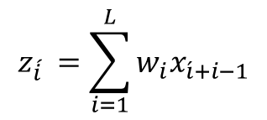
1D Convolution
Z =
z1
z2
L
W =
w1
w2
Correlation/ similarity
X =
x1
x2
x3
Notes:
You have filters and you are searching in an image the shapes of the filters. Learning is about finding filters that are good for detecting objects. Generally, finding properties of data occurring more often than noise.

Slide 17
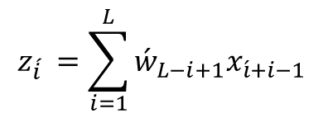
1D Convolution
Z =
z1
z2
L
W =
w1
w2
Correlation/ similarity
X =
x1
x2
x3
Flip
w2
Convolution
Ẃ =
w1
Notes:
You have filters and you are searching in an image the shapes of the filters. Learning is about finding filters that are good for detecting objects. Generally, finding properties of data occurring more often than noise. W bar is W with flipped parameters. Stride is number of steps a filter moves over the image, typically is one. Zero padding is also another common practice to acquire feature map equivalent to image.

Slide 18
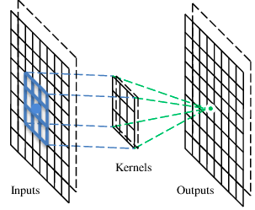
A convolutional layer
A CNN is a neural network with some convolutional layers
(and some other layers). A convolutional layer has a number
of filters that does convolutional operation.
Beak detector
A filter

Slide 19
Convolution
These are the network parameters to be learned.
1 | -1 | -1
-1 | 1 | -1
-1 | -1 | 1
1 | 0 | 0 | 0 | 0 | 1
0 | 1 | 0 | 0 | 1 | 0
0 | 0 | 1 | 1 | 0 | 0
1 | 0 | 0 | 0 | 1 | 0
0 | 1 | 0 | 0 | 1 | 0
0 | 0 | 1 | 0 | 1 | 0
Filter 1
-1 | 1 | -1
-1 | 1 | -1
-1 | 1 | -1
Filter 2
……
6 x 6 image
Each filter detects a small pattern (3 x 3).

Slide 20
Convolution
1 | -1 | -1
-1 | 1 | -1
-1 | -1 | 1
Filter 1
stride=1
1 | 0 | 0 | 0 | 0 | 1
0 | 1 | 0 | 0 | 1 | 0
0 | 0 | 1 | 1 | 0 | 0
1 | 0 | 0 | 0 | 1 | 0
0 | 1 | 0 | 0 | 1 | 0
0 | 0 | 1 | 0 | 1 | 0
Dot
product
3
-1
6 x 6 image

Slide 21
Convolution
1 | -1 | -1
-1 | 1 | -1
-1 | -1 | 1
Filter 1
If stride=2
1 | 0 | 0 | 0 | 0 | 1
0 | 1 | 0 | 0 | 1 | 0
0 | 0 | 1 | 1 | 0 | 0
1 | 0 | 0 | 0 | 1 | 0
0 | 1 | 0 | 0 | 1 | 0
0 | 0 | 1 | 0 | 1 | 0
3
-3
6 x 6 image

Slide 22
Convolution
1 | -1 | -1
-1 | 1 | -1
-1 | -1 | 1
Filter 1
stride=1
1 | 0 | 0 | 0 | 0 | 1
0 | 1 | 0 | 0 | 1 | 0
0 | 0 | 1 | 1 | 0 | 0
1 | 0 | 0 | 0 | 1 | 0
0 | 1 | 0 | 0 | 1 | 0
0 | 0 | 1 | 0 | 1 | 0
3
-1
-3
-1
-3
1
0
-3
-3
-3
0
1
3
-2
-2
-1
6 x 6 image

Slide 23
Convolution
-1 | 1 | -1
-1 | 1 | -1
-1 | 1 | -1
Filter 2
stride=1
Repeat this for each filter
1 | 0 | 0 | 0 | 0 | 1
0 | 1 | 0 | 0 | 1 | 0
0 | 0 | 1 | 1 | 0 | 0
1 | 0 | 0 | 0 | 1 | 0
0 | 1 | 0 | 0 | 1 | 0
0 | 0 | 1 | 0 | 1 | 0
3
-1
-3
-1
-1
-1
-1
-1
-3
1
0
-3
-1
-1
-2
1
Feature
Map
-3
-3
0
1
-1
-1
-2
1
3
-2
-2
-1
6 x 6 image
-1
0
-4
3
Two 4 x 4 images
Forming 2 x 4 x 4 matrix

Slide 24
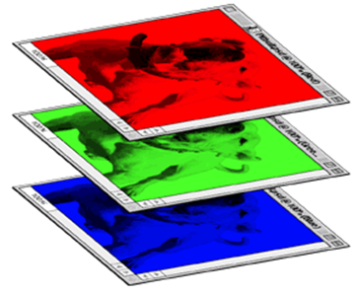
Color image: RGB 3 channels
1 | -1 | -1
-1 | 1 | -1
-1 | -1 | 1
-1 | 1 | -1
-1 | 1 | -1
-1 | 1 | -1
1 | -1 | -1
-1 | 1 | -1
-1 | -1 | 1
-1 | 1 | -1
-1 | 1 | -1
-1 | 1 | -1
1 | -1 | -1
-1 | 1 | -1
-1 | -1 | 1
-1 | 1 | -1
-1 | 1 | -1
-1 | 1 | -1
Filter 1
Filter 2
Color image
1 | 0 | 0 | 0 | 0 | 1
0 | 1 | 0 | 0 | 1 | 0
0 | 0 | 1 | 1 | 0 | 0
1 | 0 | 0 | 0 | 1 | 0
0 | 1 | 0 | 0 | 1 | 0
0 | 0 | 1 | 0 | 1 | 0
1 | 0 | 0 | 0 | 0 | 1
0 | 1 | 0 | 0 | 1 | 0
0 | 0 | 1 | 1 | 0 | 0
1 | 0 | 0 | 0 | 1 | 0
0 | 1 | 0 | 0 | 1 | 0
0 | 0 | 1 | 0 | 1 | 0
1 | 0 | 0 | 0 | 0 | 1
0 | 1 | 0 | 0 | 1 | 0
0 | 0 | 1 | 1 | 0 | 0
1 | 0 | 0 | 0 | 1 | 0
0 | 1 | 0 | 0 | 1 | 0
0 | 0 | 1 | 0 | 1 | 0

Slide 25
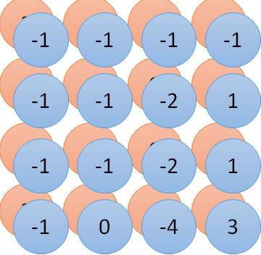



Convolution v.s. Fully Connected
1 | 0 | 0 | 0 | 0 | 1
0 | 1 | 0 | 0 | 1 | 0
0 | 0 | 1 | 1 | 0 | 0
1 | 0 | 0 | 0 | 1 | 0
0 | 1 | 0 | 0 | 1 | 0
0 | 0 | 1 | 0 | 1 | 0
1 | -1 | -1
-1 | 1 | -1
-1 | -1 | 1
-1 | 1 | -1
-1 | 1 | -1
-1 | 1 | -1
convolution
image
1 | 0 | 0 | 0 | 0 | 1
0 | 1 | 0 | 0 | 1 | 0
0 | 0 | 1 | 1 | 0 | 0
1 | 0 | 0 | 0 | 1 | 0
0 | 1 | 0 | 0 | 1 | 0
0 | 0 | 1 | 0 | 1 | 0
Fully-connected
……
……

Slide 26
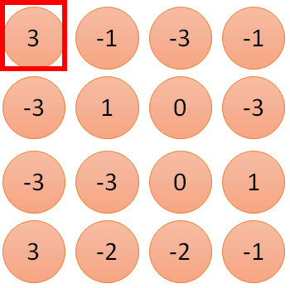

1 | -1 | -1
-1 | 1 | -1
-1 | -1 | 1
1
1
Filter 1
2
0
3
0
3
4:
0
1 | 0 | 0 | 0 | 0 | 1
0 | 1 | 0 | 0 | 1 | 0
0 | 0 | 1 | 1 | 0 | 0
1 | 0 | 0 | 0 | 1 | 0
0 | 1 | 0 | 0 | 1 | 0
0 | 0 | 1 | 0 | 1 | 0
…
7
0
8
1
9
0
10:
0
…
13
0
6 x 6 image
14
0
fewer parameters!
15
Only connect to 9 inputs, not fully connected
1
16
1
…

Slide 27
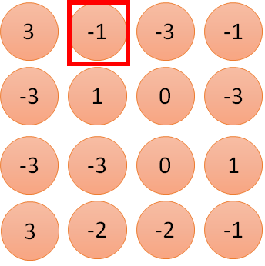


1 | -1 | -1
-1 | 1 | -1
-1 | -1 | 1
1:
1
Filter 1
2:
0
3:
0
3
4:
0
1 | 0 | 0 | 0 | 0 | 1
0 | 1 | 0 | 0 | 1 | 0
0 | 0 | 1 | 1 | 0 | 0
1 | 0 | 0 | 0 | 1 | 0
0 | 1 | 0 | 0 | 1 | 0
0 | 0 | 1 | 0 | 1 | 0
…
7:
0
8:
1
-1
9:
0
10:
0
…
13:
0
6 x 6 image
14:
0
Fewer parameters
15:
1
16:
1
Shared weights
Even fewer parameters
…

Slide 28
A Closer Look at Spatial Dimensions
7*7 input (spatially)
Assume 3*3 size filter

Slide 29
A Closer Look at Spatial Dimensions
7*7 input (spatially)
Assume 3*3 size filter

Slide 30
A Closer Look at Spatial Dimensions
7*7 input (spatially)
Assume 3*3 size filter

Slide 31
A Closer Look at Spatial Dimensions
7*7 input (spatially)
Assume 3*3 size filter

Slide 32
A Closer Look at Spatial Dimensions
7*7 input (spatially)
Assume 3*3 size filter→ 5*5 output

Slide 33
A Closer Look at Spatial Dimensions
7*7 input (spatially)
Assume 3*3 size filter with stride of 2

Slide 34
A Closer Look at Spatial Dimensions
7*7 input (spatially)
Assume 3*3 size filter with stride of 2

Slide 35
A Closer Look at Spatial Dimensions
7*7 input (spatially)
Assume 3*3 size filter→ 3*3 output

Slide 36
A Closer Look at Spatial Dimensions
7*7 input (spatially)
Assume 3*3 size filter with stride of 3
What will be output size?

Slide 37
A Closer Look at Spatial Dimensions
7*7 input (spatially)
Assume 3*3 size filter with stride of 3
What will be output size?
Doesn’t fit, you cannot do it.

Slide 38
A Closer Look at Spatial Dimensions
F
7*7 input (spatially)
Assume 3*3 size filter with stride of 3
Output size: (N-F)/stride+1
e.g. N = 7, F = 3
Stride 1 → (7-3)/1+1 = 5
Stride 3 → (7-3)/3 +1 = 2.33
F
N
N

Slide 39
Zero Padding
0
0
0
0
0
7*7 input (spatially)
Assume 3*3 size filter with stride of 1 → 7*7 output
Zero padding with (F-1)/2 will preserve size spatially
e.g.
F=3 → zero pad with 1
F=5 → zero pad with 2
F=7 → zero pad with 3
0
0

Slide 40
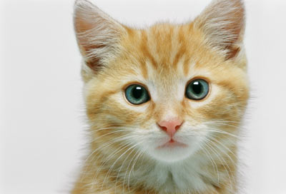

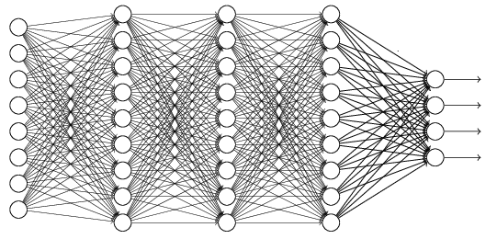





The whole CNN
cat dog ……
Convolution
Max Pooling
Can repeat many times
Fully Connected Feedforward network
Convolution
Max Pooling
Flattened

Slide 41
Max Pooling
1 | -1 | -1
-1 | 1 | -1
-1 | -1 | 1
-1 | 1 | -1
-1 | 1 | -1
-1 | 1 | -1
Filter 1
Filter 2
3
-1
-3
-1
-1
-1
-1
-1
-3
1
0
-3
-1
-1
-2
1
-3
-3
0
1
-1
-1
-2
1
3
-2
-2
-1
-1
0
-4
3

Slide 42
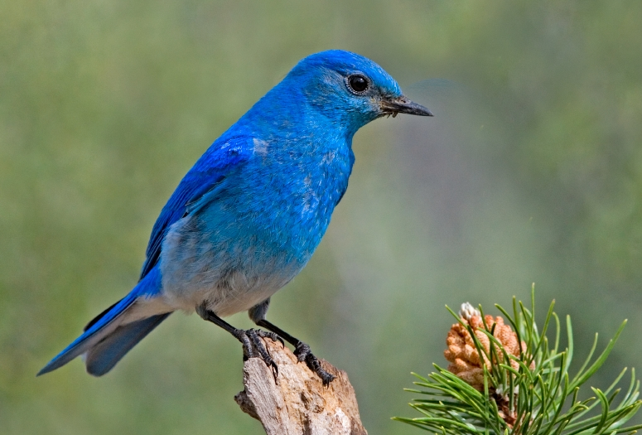

Why Pooling
Subsampling pixels will not change the object
bird
bird
Subsampling
We can subsample the pixels to make image smaller
fewer parameters to characterize the image

Slide 43
A CNN compresses a fully connected network in two ways:
Reducing number of connections
Shared weights on the edges
Max pooling further reduces the complexity

Slide 44
Max Pooling
New image
but smaller
1 | 0 | 0 | 0 | 0 | 1
0 | 1 | 0 | 0 | 1 | 0
0 | 0 | 1 | 1 | 0 | 0
1 | 0 | 0 | 0 | 1 | 0
0 | 1 | 0 | 0 | 1 | 0
0 | 0 | 1 | 0 | 1 | 0
Conv
3
0
-1
1
Max
Pooling
3
1
0
3
2 x 2 image
6 x 6 image
Each filter
is a channel

Slide 45

The whole CNN
3
0
-1
1
Convolution
3
1
0
3
Max Pooling
Can repeat many times
A new image
Convolution
Smaller than the original image
The number of channels is the number of filters
Max Pooling

Slide 46



The whole CNN
cat dog ……
Convolution
Max Pooling
Fully Connected Feedforward network
A new image
Convolution
Max Pooling
Flattened
A new image

Slide 47

















Flattening
3
0
1
3
0
-1
1
3
3
1
-1
0
3
Flattened
1
Fully Connected Feedforward network
0
3

Slide 48
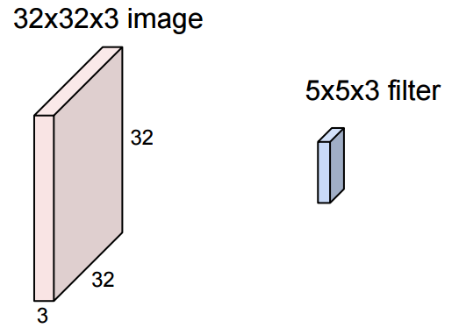
From Matrices to Tensors: Working With 3D Images

Slide 49
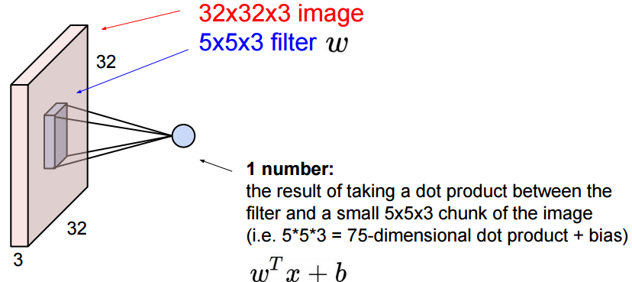
From Matrices to Tensors: Working With 3D Images

Slide 50
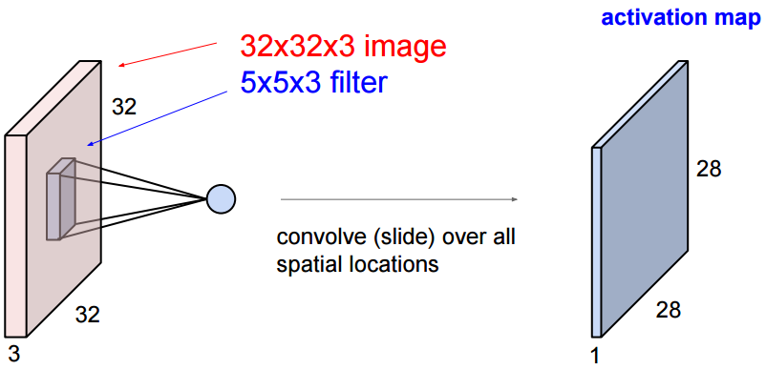
From Matrices to Tensors: Working With 3D Images

Slide 51
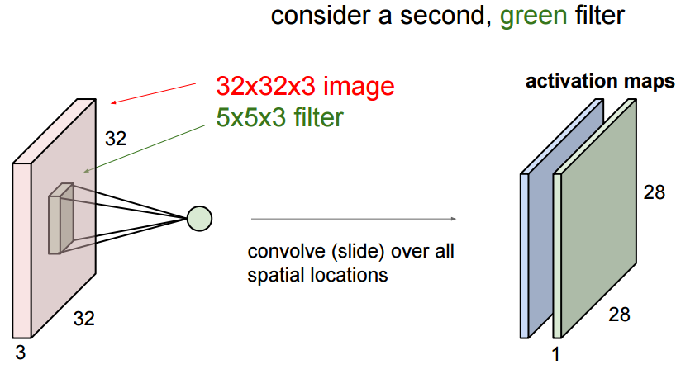
From Matrices to Tensors: Working With 3D Images

Slide 52
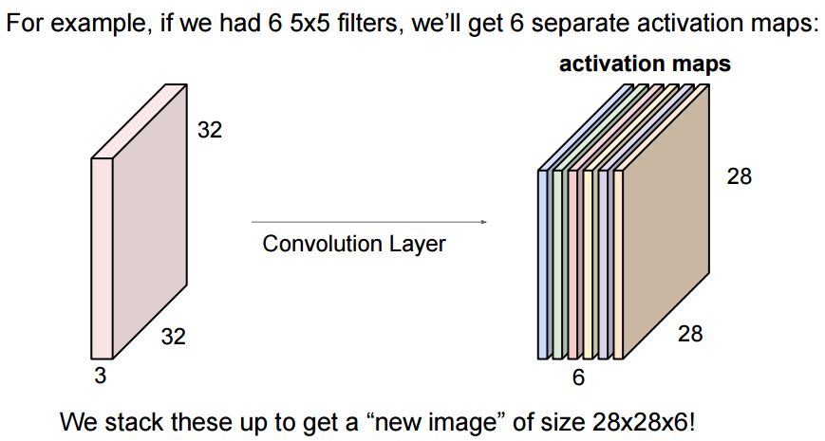
From Matrices to Tensors: Working With 3D Images

Slide 53
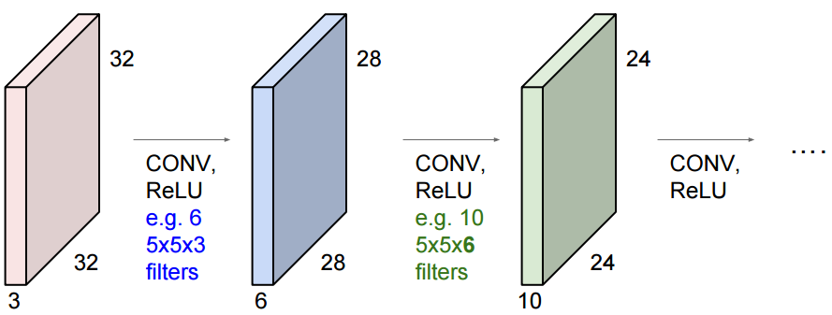
From Matrices to Tensors: Working With 3D Images

Slide 54
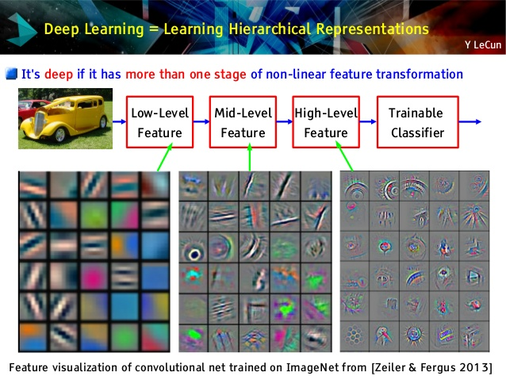

Slide 55
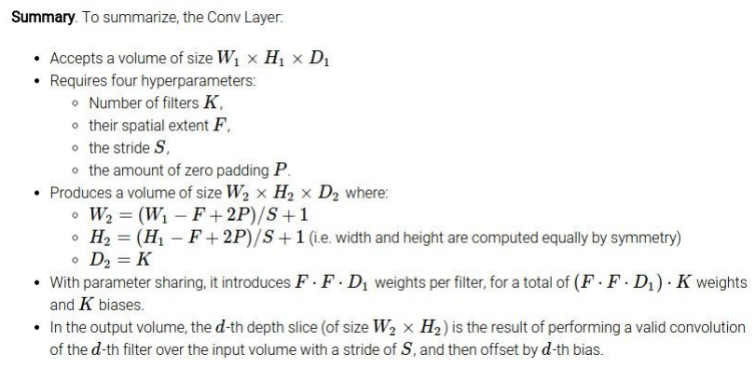
Convolutional Layer Settings

Slide 56
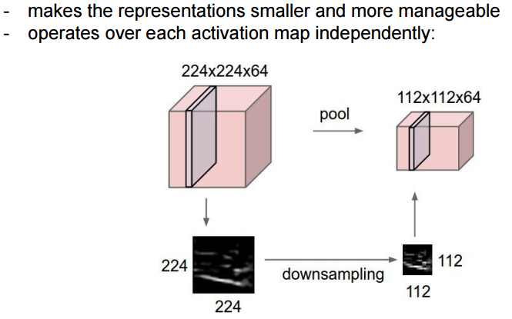
Pooling

Slide 57
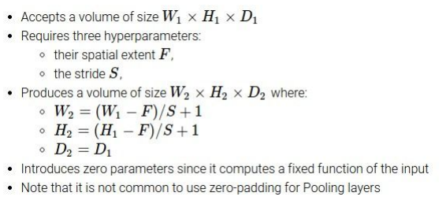
Pooling Layer Settings

Slide 58
Question
Input volume: 32*32*3
10 5*5 filter with stride 1 pad 2
Output size ?
Number of parameters?

Slide 59
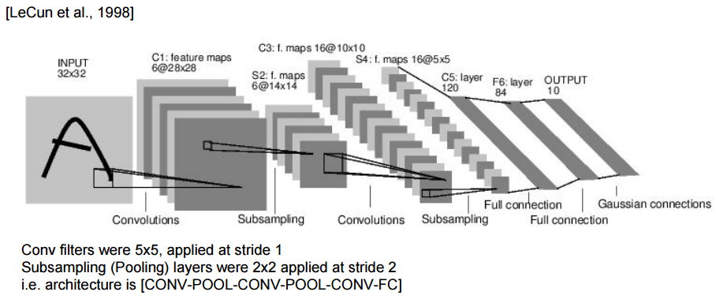
LeNet-5

Slide 60
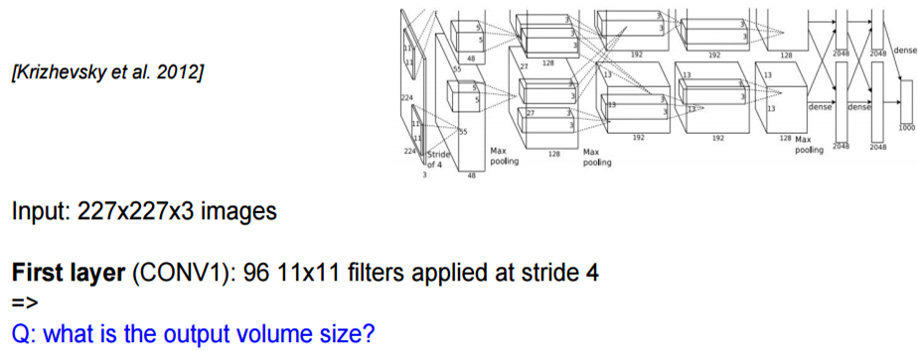
AlexNet-2012

Slide 61
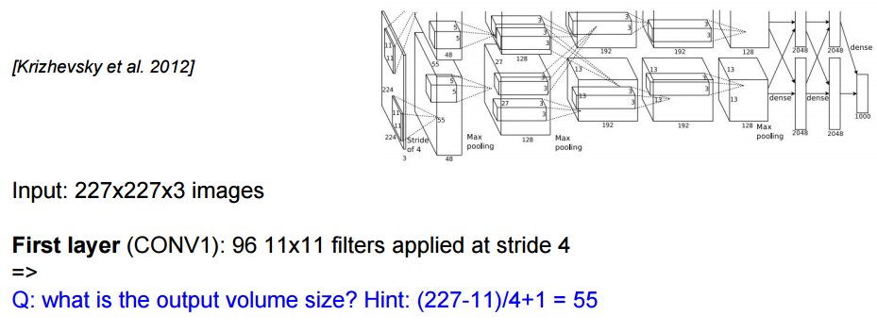
AlexNet-2012

Slide 62
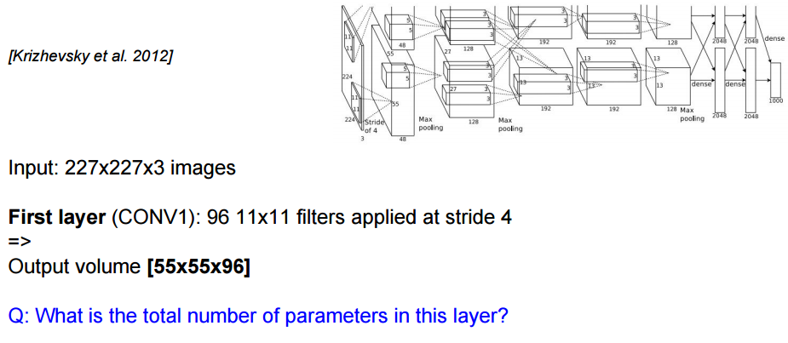
AlexNet-2012

Slide 63
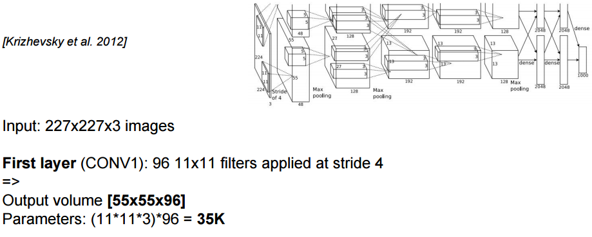
AlexNet-2012

Slide 64
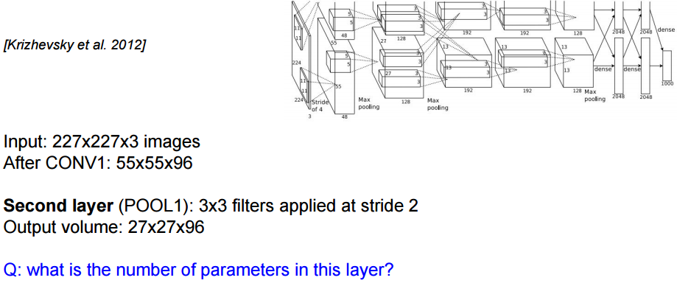
AlexNet-2012

Slide 65
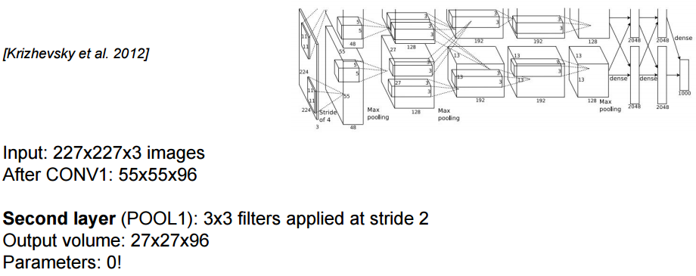
AlexNet-2012

Slide 66
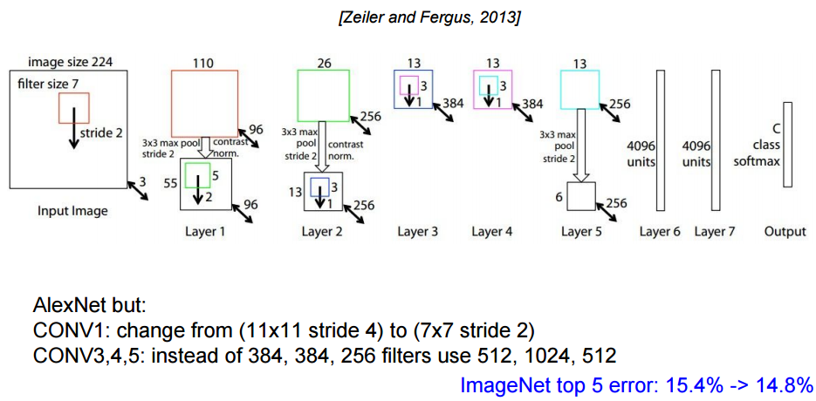
ZFNet-2013

Slide 67
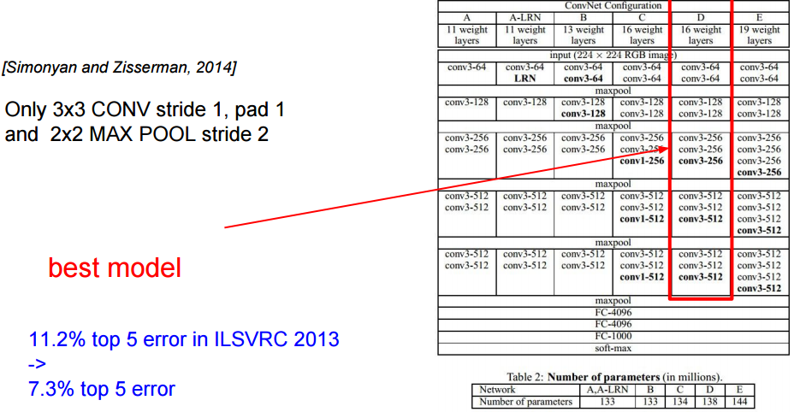
VGGNet-2014

Slide 68
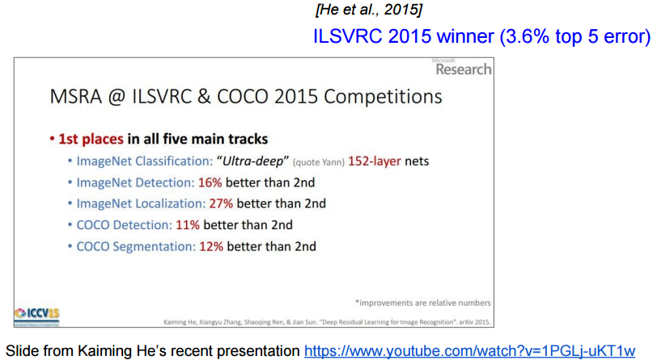
ResNet-2015

Slide 69
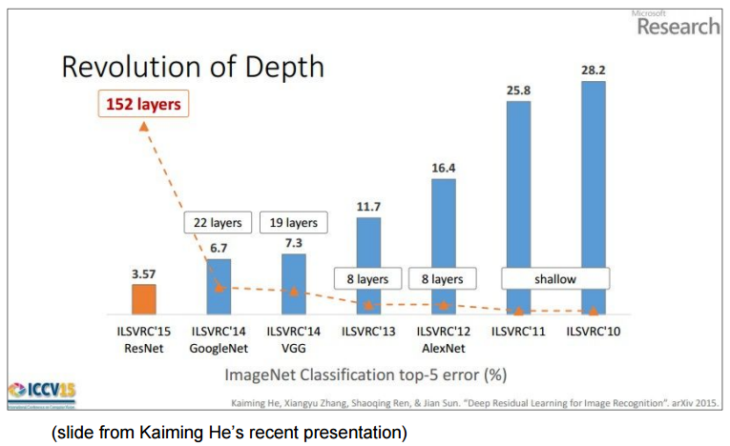
ResNet-2015

Slide 70
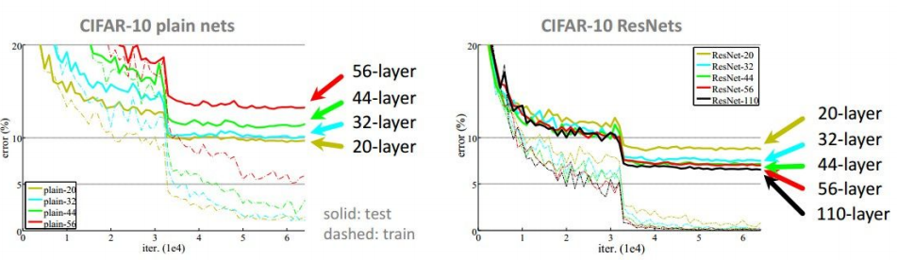
ResNet-2015

Slide 71
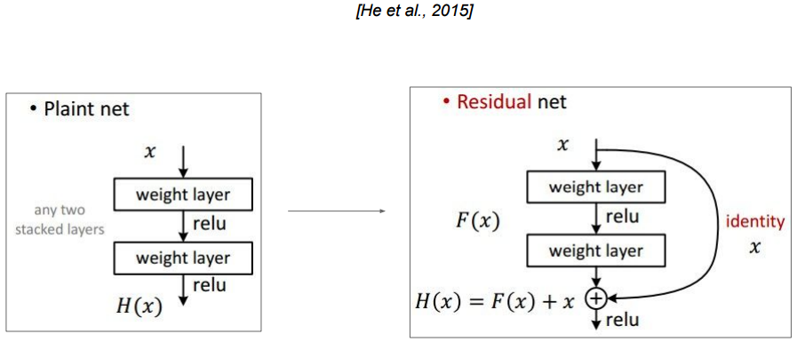
ResNet-2015

Slide 72







CNN in Keras
Only modified the network structure and input format (vector -> 3-D tensor)
input
Convolution
1 | -1 | -1
-1 | 1 | -1
-1 | -1 | 1
-1 | 1 | -1
-1 | 1 | -1
-1 | 1 | -1
There are 25 3x3 filters.
……
Max Pooling
Input_shape = ( 28 , 28 , 1)
28 x 28 pixels
1: black/white, 3: RGB
Convolution
3
-1
3
Max Pooling
-3
1

Slide 73


CNN in Keras
Only modified the network structure and input format (vector -> 3-D array)
Input
1 x 28 x 28
Convolution
How many parameters for each filter?
9
25 x 26 x 26
Max Pooling
25 x 13 x 13
Convolution
How many parameters
for each filter?
225=
25x9
50 x 11 x 11
Max Pooling
50 x 5 x 5

Slide 74

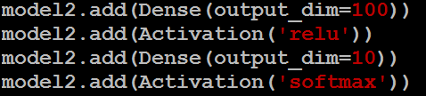

CNN in Keras
Only modified the network structure and input format (vector -> 3-D array)
Input
1 x 28 x 28
Output
Convolution
25 x 26 x 26
Fully connected feedforward network
Max Pooling
25 x 13 x 13
Convolution
50 x 11 x 11
Max Pooling
1250
50 x 5 x 5
Flattened

Slide 75
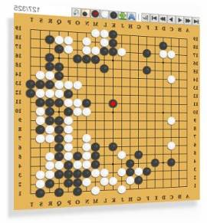


AlphaGo
Neural
Network
Next move
(19 x 19 positions)
19 x 19 matrix
Fully-connected feedforward network can be used
Black: 1
white: -1
none: 0
But CNN performs much better

Slide 76

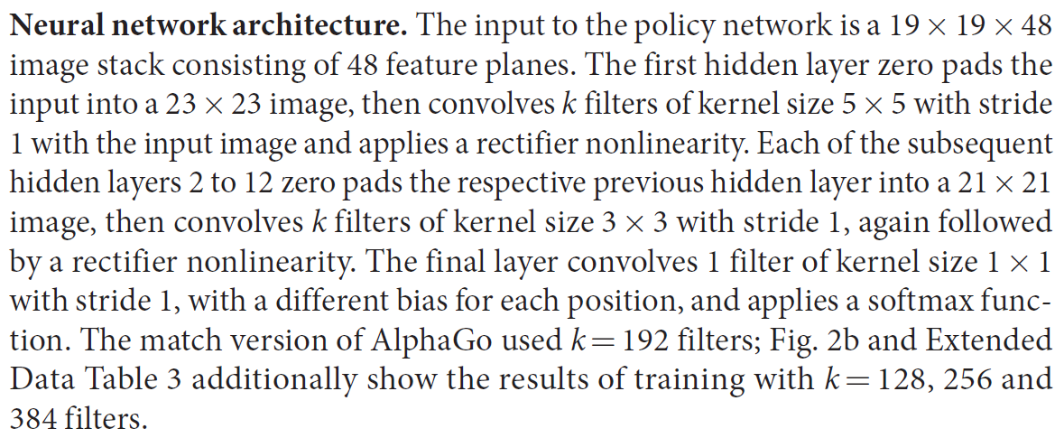
AlphaGo’s policy network
The following is quotation from their Nature article:
Note: AlphaGo does not use Max Pooling.

Slide 77
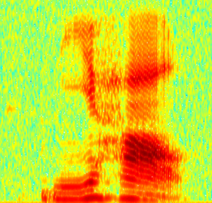
CNN in speech recognition
The filters move in the frequency direction.
CNN
Frequency
Image
Time
Spectrogram

Slide 78
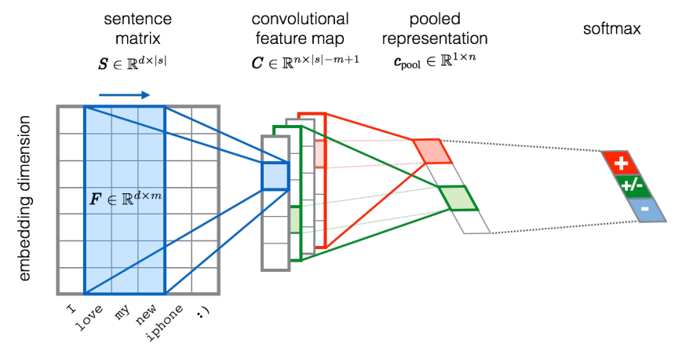
CNN in text classification
?
Source of image: http://citeseerx.ist.psu.edu/viewdoc/download?doi=10.1.1.703.6858&rep=rep1&type=pdf

